Slide 1
8” WAFER FAB PROCESS
By ADARSH MISHRA

Slide 2
Clean Room
SCL has Cleanrooms of class 1,10, 100 and 1000
Types of contamination
1. Particles
2. Metallic impurities
3. Organic contamination
4. Native oxides
Contamination Control
1. Filtration
2. Cleanroom Garments
3. Commodities and Cosmetics
4. Measurement and Instrumentation

Slide 3
DIFFUSION
Diffusion is the process by which a species moves in the presence of a concentration gradient and energy.
If there is an Dopant concentration gradient present, ∂C/∂ x, in a finite volume, there will be a tendency for the dopant material to move so that a decrease in the gradient is produced.
Concentration gradient and energy ( in the form of heat) are the major requirements for diffusion.
Dopants can be in solid, liquid or gaseous form.

Slide 4
MATHEMATICS OF DIFFUSION
Fick's First Law
Whenever an impurity concentration gradient, ∂C/∂x, exists in a finite volume of a matrix substance (the silicon substrate in this context), the impurity material will have the natural tendency to move in order to distribute itself more evenly within the matrix and decrease the gradient.
In 1855 by Fick, who postulated that the flux of material (No. of atoms crossing unit area per unit time) across a given plane is proportional to the concentration gradient across the plane.
F = - D ( ∂C(x,t)/∂x )
F - Flux,
D - Diffusion constant/ diffusion coefficient/ diffusivity (µm²/s) and
∂C(x,t)/∂x - Concentration gradient.
The negative sign of the right side of the equation indicates that the impurities are flowing in the direction of lower concentration.
A
Flow direction

Slide 5
MATHEMATICS OF DIFFUSION
Fick's Second Law
Fick's First Law does not consider the fact that the gradient and local concentration of the impurities in a material decreases with an increase in time, an aspect that's important to diffusion processes.
The flux F1 of impurities entering a section of a bar with a concentration gradient is different from the flux F2 of impurities leaving the same section.
This is Fick's Second Law, which states that the change in impurity concentration over time is equal to the change in local diffusion flux, or
∂C(x,t)/∂t = - ∂J/∂x
∂C(x,t)/∂t = ∂(D∂C(x,t)/∂x)/∂x. ( From Fick’s First Law)
∂C(x,t)/∂t = D ∂²C(x,t)/∂x².

Slide 6
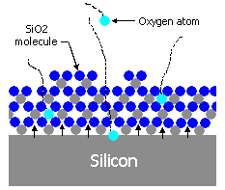
Oxidation.
Definition
Oxidation of Si is a process in which either O₂ or water vapor (H₂O) react with the silicon and produce SiO₂ layer.
SiO2 on a Silicon wafer is a chemically stable protective layer₂ which makes silicon the most widely used semiconductor substrate.
There are two type of oxidation :–
-WET
- DRY

Slide 7
Oxidation.
WET OXIDATION
Si + 2H₂ O(Vapor) SiO₂ + 2H₂
Water vapor Formation by Pyrogenic/Hydrox Torch
H₂ (15slm) + O₂( 8 slm) H₂O (Vapor)
Rate of Wet oxidation is around approximately 4 times more than that of dry oxidation.
Changes in the OH content of the oxide (i.e SiOH) tends to “loosen” the structure of SiO₂ with change in the viscosity, R.I, film density. Thus the quality of the WOX film is poorer than that of DOX.
^{850 °C /1000 °C}
^{840 °C}

Slide 8
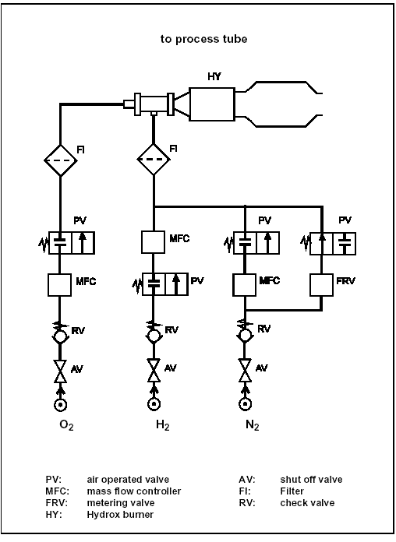
Oxidation. WET OXIDATION HYDROX TORCH SET-UP :-

Slide 9
Oxidation
DRY OXIDATION/ DRY OXIDATION + DCE
Si + O₂ SiO₂
For removal of contaminants and cleaning of the quartz tube DCE (C₂H₂Cl₂) is used, which decomposes at oxidation temp and produces Cl¯ as follows
2C₂H₂Cl₂ + O₂ 2CO₂ + 2H₂+4Cl ¯
4Cl ¯ + 4Na⁺ 4NaCl (vapor)
Moreover, the addition of DCE enhances the oxidation rate by 4% and increases breakdown strength of the SiO₂.
^{1000 °C /1050 °C}
^{1000 °C /1050 °C}
^{1000 °C /1050 °C}

Slide 10
FACTORS WHICH AFFECT OXIDATION RATE
Crystal orientation
Number of silicon atoms/bonds available for reaction, so hike in linear rate constt (B/A).
Oxidation rate: (110) > (111) > (100) upto 150 A of SiO2
Oxidation rate: (111) > (110) > (100) for oxide greater than 150A.
Orientation dependence (due to steric hindrance) of activation energy that is required to initiate the reaction.
Dopant Type & Concentration
Increase in both the constants (B & B/A) at high doping (>10¹⁹ cm-3).
In case of ‘Boron’, linear rate constant (B/A) has negligible effects however the parabolic rate constant (B) increases rapidly.
Attributed to weakening of bond structure of SiO2 (since boron segregates in SiO2).
In case of ‘Phosphorus’ which segregates into the silicon, high conc. of phosphorus shifts the position of Fermi level, which in turn increases the surface vacancy [V] concentration. The vacancies are thought to provide the additional sites for reaction of oxidizing species with the silicon thereby increasing (B/A).

Slide 11
FACTORS WHICH AFFECT OXIDATION RATE
Ambient (O2 or H2O)
The linear rate constt. (B/A) and parabolic rate constt. (B) is very high in case of wet oxidation. Actually the solid solubility (C*) of H2O in SiO2 is very high (about 1000 times higher than of O2) which affects the hike in parabolic rate constt.
DCE/TCE/TCA/HCl (Chlorine containing gas) presence
A little amount of water vapor formation in the oxide increases the parabolic rate constt.
Halogen reacts with Si and creates vacancies [V] to increase the oxidation. This is the main factor which affects the oxidation rate (B/A).
Temperature
Both the constants (linear as well as parabolic) are temp. dependent as per Arrhenious equation and increases with temp.
Pressure
Pressure increases both the linear rate (B/A) constt. and parabolic rate constt. (B). This is attributed to increases in the C*, the equilibrium bulk conc. of the oxidizing species in the oxide, which is proportional to partial pressure of the oxidizing species ( henry law).
C α P

Slide 12
OXIDE FURNACE C-V QUALIFICATION
C-V (Capacitance-Voltage) measurement is done periodically for quartz tube qualification.This is the most common oxide quality monitoring diagnostic employed in semiconductor device manufacturing. C–V plot provides useful informations like mobile ion concentration, substrate doping and oxide charges etc. These are the main sources of furnace contamination as well as device failure.

Slide 13
Photolithography
Photolithography is transfer of the required geometric pattern onto the wafer or layer using light.
One of the most important processes in CMOS fabrication
Determines the minimum feature size of the device

Slide 14
Process flow
Priming
Wafer is coated with a primer (HMDS).
This is done to ensure the photo resist adhesion to the surface.
ARC
An anti-reflective coating is applied to the substrate to minimize reflection and enhance the contrast during the exposure step.
Pre heating of the wafer is done to remove any moisture present.
The wafer is placed on a chill plate to ensure that the coated resist does not evaporate too rapidly due to its high temperature.
To be continued

Slide 15
Photoresist
A layer of photoresist material is spin-coated onto the substrate.
Spin Dry
The wafer is rotated at high speed to evenly spread out the dispensed photo resist.
The wafer is rotated at high speed to evenly spread out the dispensed photo resist.
To be continued

Slide 16
Soft
Bake
This is done to vaporize any solvent remaining in the photo resist and to improve the uniformity and adhesion of the resist layer.
Mask Alignment & Exposure
The photoresist-coated substrate is aligned with a photomask, which contains the desired pattern to be transferred.
The substrate is exposed to ultraviolet (UV) light through the photomask. The UV light passes through the transparent areas of the mask, exposing the corresponding regions of the photoresist.
To be continued

Slide 17
Post Exposure Bake
The exposed substrate is subjected to a post-exposure bake process. This step enhances the chemical reactions in the photoresist and helps to define the desired pattern.
Development
The substrate is immersed in a developer solution that selectively removes the exposed regions of the photoresist.
Hard Bake
(optional)
This is done to harden the photo resist and improve its adhesion to the substrate for further processes like diffusion and ion implantation.
The substrate is rinsed with a solvent, such as DI water, to remove any remaining developer solution and photoresist residues.
also known as post development bake.

Slide 18
Light sources
The two commonly used wavelengths are 436nm (g-line) & 365nm (i- line). However use of i-line became dominant because of better resolution it provides.
The two types of light sources used in photolithography are:
1. High Pressure Arc Lamp
2. Excimer laser

Slide 19
High Pressure Arc Lamp
A high intensity electric arc is passed through a gas filled quartz bulb to produce light.
The vapour pressure ranges from 30-40 bars.
The gas inside the bulb, typically mercury or xenon, is excited by the arc discharge, resulting in the emission of intense UV light.
Typical power consumption is around 2.5kW.
It offers relatively lower cost compared to some other light sources, and they provide a stable and consistent light output over a long period of time.

Slide 20
Excimer Lasers
Excimer lasers use a combination of gases, typically a noble gas (such as argon, Krypton) and a halogen gas (such as fluorine), to create a laser beam.
The gases are excited by an electrical discharge, producing short-pulsed UV light with specific wavelengths.
Bandwidth of about 1 nm.
KrF (248 nm) and ArF (193 nm), emerged as the brightest deep UV light sources.

Slide 21
PhotoResists
The word Photoresist comes from the combination of photosensitive and acid resistant, i.e. a photoresist can be photographically patterned and will stand up to acid etch, enabling patterned etching.
They serve two important functions:
Transferring the pattern from the mask onto the wafer.
Protecting the underlying substrate in subsequent processes.

Slide 22
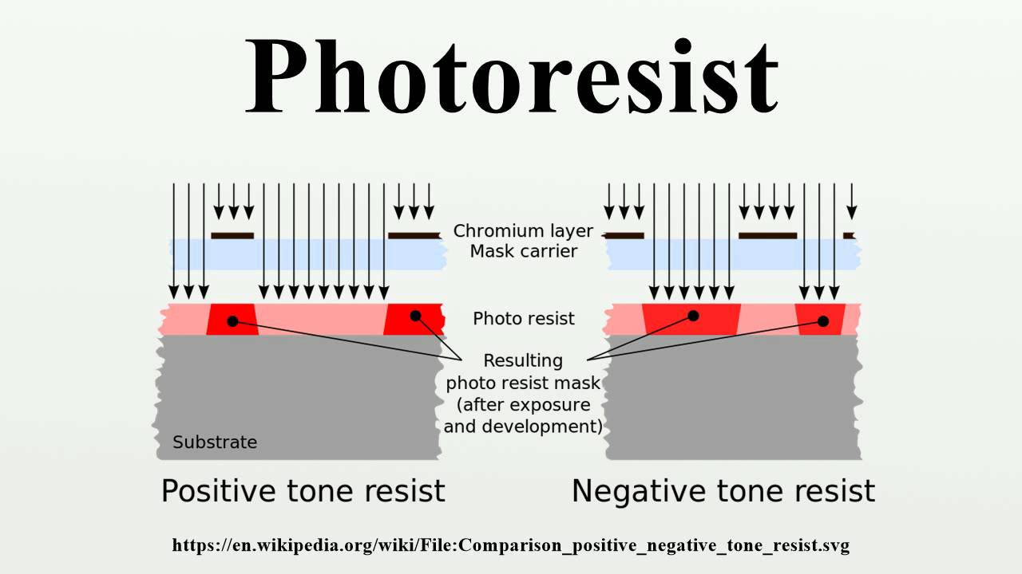
Types of PhotoResist
There are two types of Photo resist:
Positive photoresist: The section which gets more exposed to light becomes soluble in developer solution.
Negative photoresist: The solution which on exposure to light becomes insoluble in developer solution

Slide 23
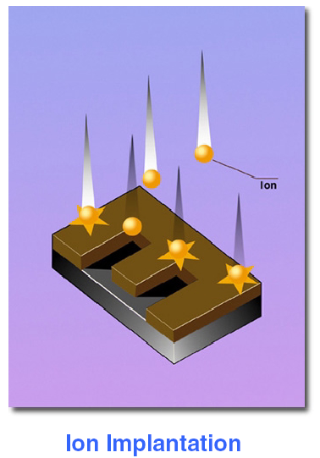

Ion implantation and its history
A gas is ionized, and the ions are accelerated by a high electric field, and injected into the target wafer to hundreds of nm depth.
Typical ion implantation parameters:
Ion: P, As, Sb, B, In, O
Dose: 10¹¹ - 10¹⁸ cm⁻²
Ion energy: 1 - 400 keV
Uniformity and reproducibility: ±1%
Temperature: room temperature
Ion flux: 10¹²-10¹⁴ cm⁻²s⁻¹
Dose (φ) = # of atoms/cm².
Concentration (C) = # of atoms/cm³.
The idea was proposed by Shockley in 1954, but used for mass production only after late 1970s.
Before ion implantation, doping is achieved by diffusion into the bulk silicon from gaseous source above surface, or pre-deposited chemical source on wafer surface.
This approach lacks the flexibility and control required by CMOS processing, and ion implantation quickly gained popularity for the introduction of dopant atoms.
Modern ion implanters were originally developed from particle accelerator technology. Their energy range spans 100eV to several MeV (a few nm’s to several microns in depth range). The implantation is always followed by a thermal activation (600-1100ºC).

Slide 24
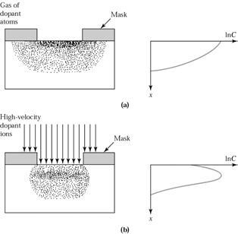
Advantages of ion implantation
Very precise dose control.
The ion implanter forms a simple electrical circuit. By monitoring the current in the circuit (or by a monitoring circuit with Faraday cups), significant accuracy in the implanted dose can be maintained. Assuming a current sensitivity of nA, and a minimum required implantation time of 10 seconds, it can be shown that doses as low as 10¹¹cm⁻², can be measured.
On the contrary, in chemical source predeposits, dose values less than 5×10¹³/cm² are not achievable.
High dose introduction is not limited to solid solubility limit values.
Excellent doping uniformity is achieved across the wafer (< 1% variation across 12” wafer) and from wafer to wafer.
Less dopant lateral diffusion, good for small device (short channel).
Done in high vacuum, it is a very clean process step.
Besides precise dose control, one can also control the profile (peak depth and spread range) better than diffusion (peak concentration always near surface).
(top) Doping by diffusion and “drive-in”.
(bottom) Doping by ion implantation with or without “drive-in”.

Slide 25
Advantages/disadvantage of ion implantation
Advantage:
Low-temperature process (can use photoresist as mask)
Wide selection of masking materials, e.g. photoresist, oxide, poly-Si, metal
Less sensitive to surface cleaning procedures.
Very fast (6" wafer can take as little as 6 seconds for a moderate dose)
Complex profiles can be achieved by multi-energy implants.
Disadvantage:
Very expensive equipment ( $1M or more).
At high dose values, throughput is less than diffusion (chemical source pre-deposition on surface).
Ions damage the semiconductor lattice. Not all the damage can be corrected by annealing.
Very shallow and very deep doping are difficult or impossible.
Masking materials can be “knocked” into the wafer creating unwanted impurities, or even destroying the quality of the interface.

Slide 26
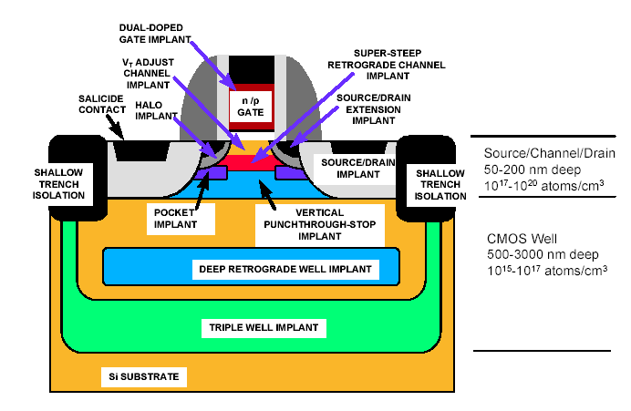
Application of ion implantation in CMOS fabrication
9-10 different implantations!

Slide 27
THIN FILM
Films of thickness typically < 2µm are called as thin films.
The deposition of metal and dielectric films.
Most of thin film activities are in back-end.
Some properties of an acceptable thin film for wafer fabrication are good step coverage, ability to fill high aspect ratio gaps, good thickness uniformity, high purity and density, controlled stoichiometries and excellent adhesion.

Slide 28
Deposition methods
CVD
PVD
Chemical vapour deposition
Precursors diffuse on the surface
Uniform step coverage
For dielectric layers
Good for deposition of film over uneven surfaces & gap fill.
E.g., APCVD, LPCVD, PECVD, HDP-CVD
Physical vapour deposition
No surface diffusion
Poor step coverage
For metal layers
Good for depositing films on flat surface.
E.g., evaporation, sputter deposition

Slide 29
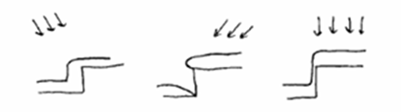
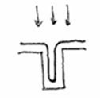
PVD
Everything sticks where it hits
CVD
Deposits evenly over the surface

Slide 30
Dielectric requirements
High electrical resistivity
Thermal stability
Good adhesion to oxide/nitride/metal/Si
Step coverage
Conformity
Gap filling
Low defect density
High dielectric strength
Low stress
Good barrier to humidity and external stresses

Slide 31
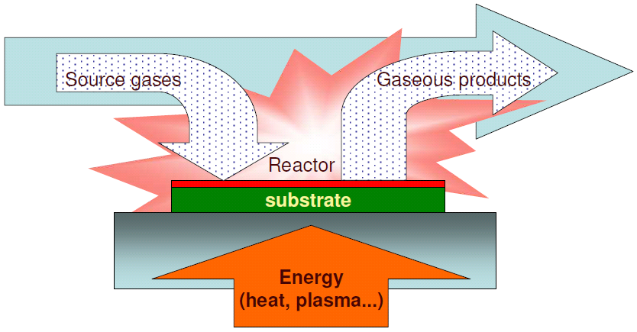
CVD – Chemical Vapor Deposition
Chemical vapour deposition (CVD) is a process where one or more volatile precursors are transported via the vapour phase to the reaction chamber, where they decompose on a heated substrate.
Reactions in the gas-phase is most often unwanted

Slide 32
CVD reaction
Gas or vapor phase precursors are introduced into the reactor
Precursors across the boundary layer and reach the surface
Precursors adsorb on the substrate surface
Adsorbed precursors migrate on the substrate surface
Chemical reaction on the substrate surface
Solid by products form nuclei on the substrate surface
Nuclei grow into islands
Islands merge into the continuous thin film
Other gaseous by products desorb from the substrate surface
Gaseous by products diffuse across the boundary layer
Gaseous by products flow out of the reactor.

Slide 33
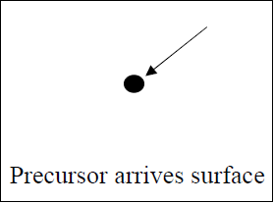
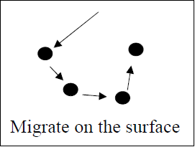
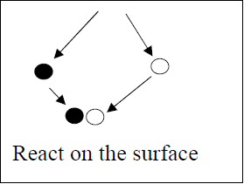
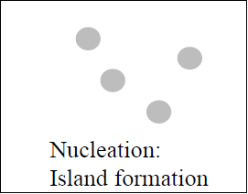
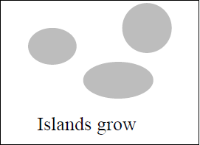
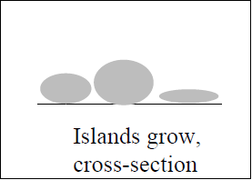
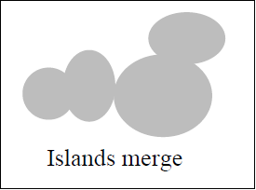
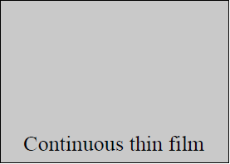
Deposition process

Slide 34
Types of CVD
APCVD (Atmospheric pressure CVD) :- simple and fast process, non uniform film thickness, poor step coverage
LPCVD (Low Pressure CVD) :- Excellent uniformity and conformity, Low deposition rate
PECVD (Plasma Enhanced CVD) :- Low temperature, risk for chemical and particle contamination
HDP-CVD (High density plasma CVD) :- better gap filling, better step coverage

Slide 35
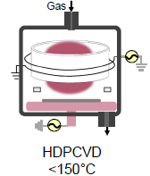
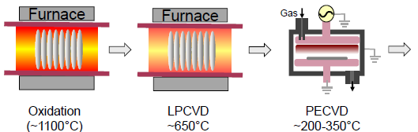

Slide 36
Plasma
Plasma is a neutral, highly energized, ionized gas.
It is used at various process steps in wafer fabrication because it supplies the energy needed to support a reaction near the wafer surface in a process chamber.
The most common method to create a plasma glow discharge is with AC power (or DC discharge between the electrodes) in the radio frequency (RF) range.

Slide 37
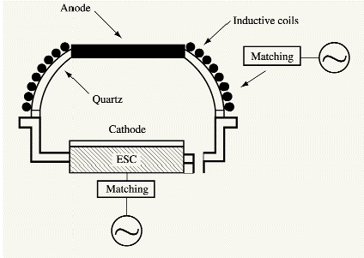
HDP-CVD (High density plasma CVD)
Trend to lower temperature processing
Better quality dielectric films than PECVD at lower temperature
high density plasma in a very low pressure is created by using high power RF energy.(Split RF biasing system is used)
Concurrent deposition and etch processes
Uniform and stoichiometric silicon dioxide composition.

Slide 38
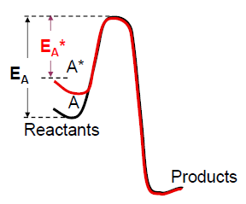
PECVD
Plasma Enhanced Chemical Vapor Deposition
Operational pressure from 1 to 10 Torr
Reactions occur at lower temperature, activation energy is lowered.
High deposition rate at relatively low temp.
RF induces plasma field in deposition gas
Stress control by RF

Slide 39
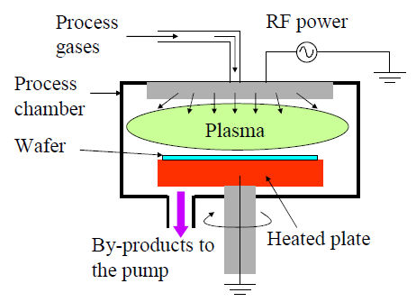
Plasma Enhanced CVD System

Slide 40

PECVD- Film Formation
Radicals are formed by electron impact.
Radicals adsorb on substrate surface
Reactions occur on surface
Thermally driven, may be some plasma interaction
Film forms and by-products generated

Slide 41
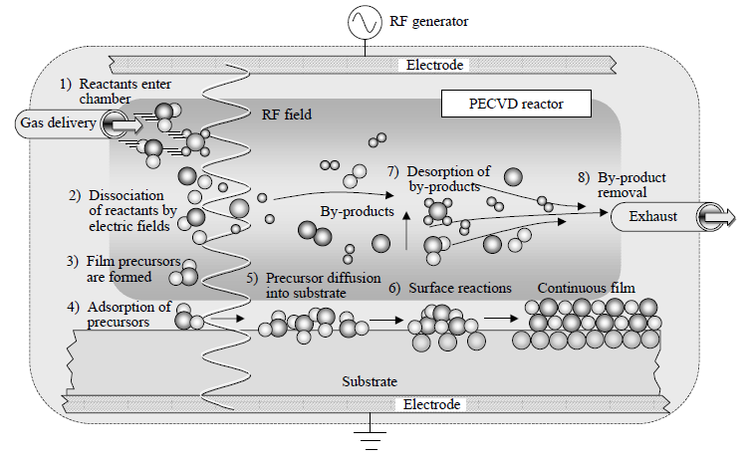

Slide 42
PECVD: Basic Film Properties
Most films formed are amorphous.
Films formed are not perfectly stoichiometric. Often significant H incorporation.
Film properties depend on plasma condition (pressure, flow, power, reactor geometry), substrate temperature, substrate material (surface, thickness).

Slide 43
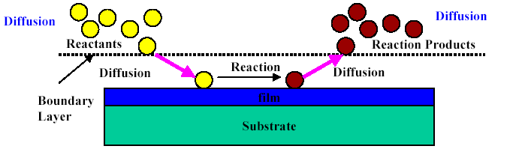
Etching
Etching is the process whereby unwanted material is removed from a wafer
Etching consists of 3 processes:
Mass transport of reactants (through a boundary layer) to the surface to be etched.
Reaction between reactants and the film to be etched at the surface.
Mass transport of reaction products from the surface boundary layer

Slide 44
Terminologies in Etching Process
Etch Rate=Thickness before etch - Thickness after etch
Etch time
Selectivity = Etch Rate of Material 1
Etch Rate of Material 2
Uniformity = Maximum etch rate - Minimum etch rate
Maximum etch rate + Minimum etch rate
Anisotropy
Loading effect discussed later.

Slide 45
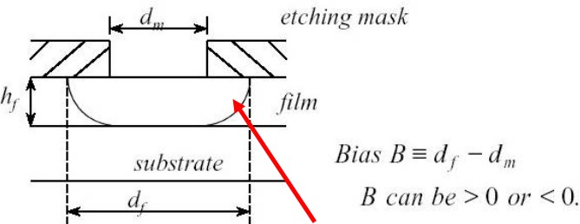
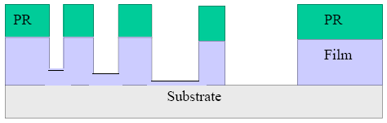
Anisotropy
Anisotropy: degree of anisotropy, A_{f}
B
A_{f} = 1 − _{2h}
f
0 ≤ A_{f} ≤ 1
undercut
Loading effect and aspect ratio etching: This occurs when Etch Rate is not uniform.

Slide 46
Types of etching
Etching
Wet etching
(isotropic)
Dry etching
(anisotropic)
chemical plasma
etching
Physical etching or
Ion milling
RIE

Slide 47
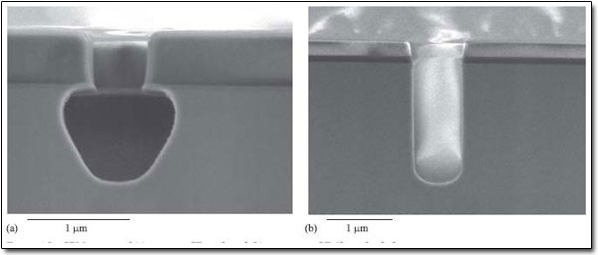
Problem of Wet Etching
Isotropic Phenomenon (Wet Etching)
Anisotropic Phenomenon (Dry Etching)
10

Slide 48
Dry Etching
Gaseous form can obtain highly anisotropic etching profiles, mainly avoid the undercutting problem of wet etching.
Common used dry etching techniques:
Plasma systems
Ion milling
Reactive ion etching(RIE)

Slide 49
Comparison
 | Wet Etch | Dry Etch
Etch Profile | Isotropic | Anisotropic to isotropic, controllable
Etch rate | High | Acceptable, controllable
Selectivity | High | Acceptable, controllable
Equipment cost | Low | High
Throughput | High (batch) | Acceptable, controllable
Chemical usage | High | Low

Slide 50
Plasma Basics
A plasma is an ionized gas with equal numbers of positive and negative charges.
A more precise definition: a plasma is a quasi-neutral gas of charged and neutral particles which exhibits collective behavior.
Three important things in plasma:
Ionization generates electrons and ions and sustains the plasma
CF₃ + eˉ CF₃⁺ + 2eˉ
Excitation-relaxation causes plasma glow color
CF₄ + eˉ CF₄* + eˉ
Disassociation creates reactive free radicals
CF₄ + eˉ CF₃ + F + eˉ

Slide 51
RF plasma
Plasmas can also be generated using an alternating current (AC). Rather than using 50Hz AC
A frequency of 13.56MHz is preferred because the electrons which are very small and light can follow the change in the electric field as it oscillates from positive to negative and back again.
The ions however are much heavier and slower and just cannot follow the field so it doesn’t directly affect them at all. This allows the plasma to be continuous.
Notes:
This is a frequency that a certain amount of power can be radiated at without interfering with communications.

Slide 52
Capacitively coupled Plasma
Power is supplied by RF to plasma via a matching network and blocking capacitor.
Capacitor ensures no Dc current flows through it.
Gas In
RF
Generator
Matching
Network
Gas Out
Blocking Capacitor
Capacitively Coupled Etching System

Slide 53
Inductively de-Coupled Plasma
Gas In
Bias RF power controls the ion energy
Source RF power controls the ion flux
Helium backside cooling system with E-chuck controls wafer temperature
It has both the properties of low pressure and high density plasma
Inductive Coils
Source
rf
Ceramic
Cover
Chamber
Body
Bias
rf
Gas Out
Inductively Coupled Etching System
Notes:
The most sold aluminium etcher in this decade uses an inductively coupled plasma source

Slide 54
Self-bias in Etch Chamber
Small electrodes have larger negative potential relative to larger ones. →self bias
Smaller electrode has more energetic ion bombardment due to self-bias
Wafers are put on small electrodes in etch chamber
V
2
A
1
A
2
DC bias V₁
V₁ = 200 to 1000 V
4
V₁/V₂ =(A₂/A₁)

Slide 55
Wet Etching
The removal of excess material from the surface of the wafer by using liquids is called Wet etching.
In this method, a solution which can etch the material is kept in a tank and the wafer is dipped in the tank for a given time, at a given temperature.
After etching, the wafers are taken out and rinsed in DI water and dried by spinning. If they are dried without spinning, some water may remain on the wafer leaving ‘water mark’.
Hence spin drying is employed. Even with spin drying, watermarks may form sometime, and in order to avoid it, isopropyl alcohol (IPA) is used for final rinse and spin drying.

Slide 56
Etch Rate & Selectivity
Etch rate measures how fast the material is removed from the surface. Factors such as Temperature, Chemical concentration and Composition of material to be etched affect the wet etch rate.
Etch rate = Δd /t Å/min
where Δd= change in thickness and t= time in min
It is measured as the ratio between different etch rates of the etchants of different materials. So a good etchants need high selectivity value with respect to both mask and substrate.
Selectivity = (Etch rate of material₁) / (Etch rate of material₂)

Slide 57
Tools in Wet Etching
There are total 12 tools in wet etch facility at SCL. These include 6 process tools, 2 metrology tools and 4 support tools.
PDC01/WTPD1: Pre diffusion cleaning
PRS01/WTRS1: PR cleaning
SHC01/WTCO1: Cobalt strip
SIN01/WTNT1: Si3N4 Stripping
SEZ01/WTSE1: Front side/backside cleaning
SST01/WTSL1: Post-metal and via etch polymer cleaning in BEOL
SRT01/SSRT1: Wafer sorter
SRT20/ SSRT2: Wafer sorter
ONT01/SONT1: On track
BXC01/SBXC1: Box cleaner

Slide 58
Advantages of Wet Etching
There are various advantages of Wet etching Process:
Low cost
High reliability
High throughput
Excellent selectivity
High reproducibility
Better efficiency in the use of etchants.

Slide 59
Limitations of Wet Etching
There are some disadvantages of wet etching are as follows:
Wet etching is isotropic
Requires large amount of etchant chemical
Pattern transfer leads to undercut in the layer
No control for precious etching

Slide 60
CMP and Yield
CMP is the process of smoothening and polishing the wafer surface, aided by chemical and mechanical forces.
Yield is fraction of total number of good chips to the total number of chips manufactured. A good chip means that it passes all functions tests that are specified for the product.
Defect inspection basically scanning wafer for defects. In this defects are found to improve yield. Defect review involves classifying defects captured during wafer inspection. In this defect images are stored for future references.

